Slide 1



EagleSat-1
Ground System and Orbital Predictions
Madison Padilla
Embry-Riddle Aeronautical University Aerospace Engineering, Junior
Presentation for
AZ/NASA Space Gant Symposium
April 21-22, 2017

Slide 2

Overview
Ground system overview
Ground system breakdown
Graphic user interface (GUI) layout
Flight dynamics overview
Analysis from flight dynamics
Questions

Slide 3
Ground System
A ground system to provide a Graphical User Interface (GUI) that is able to connect to EagleSat-I through a serial connection to the Terminal Node Controller (TNC)
View, save, observe and process data from EagleSat-I
Send commands to EagleSat-I
Matrix Laboratories (MATLAB) chosen for all ground station software

Slide 4
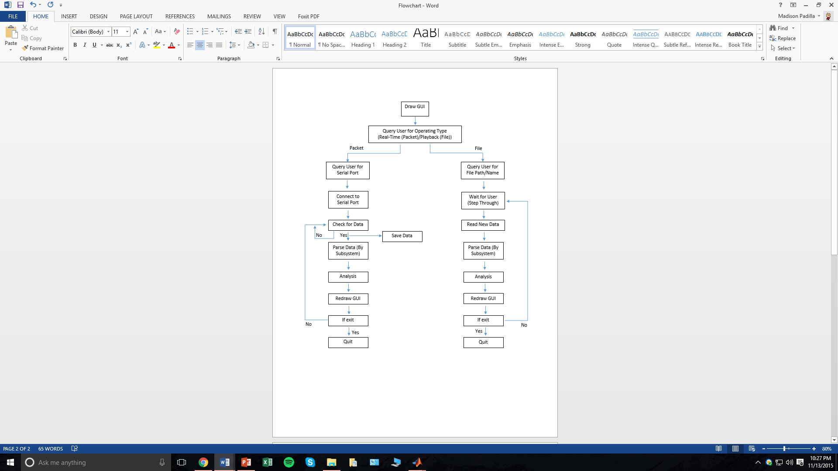
High Level Flowchart

Slide 5
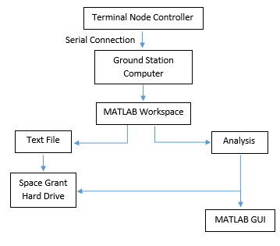
Data Flow Diagram

Slide 6
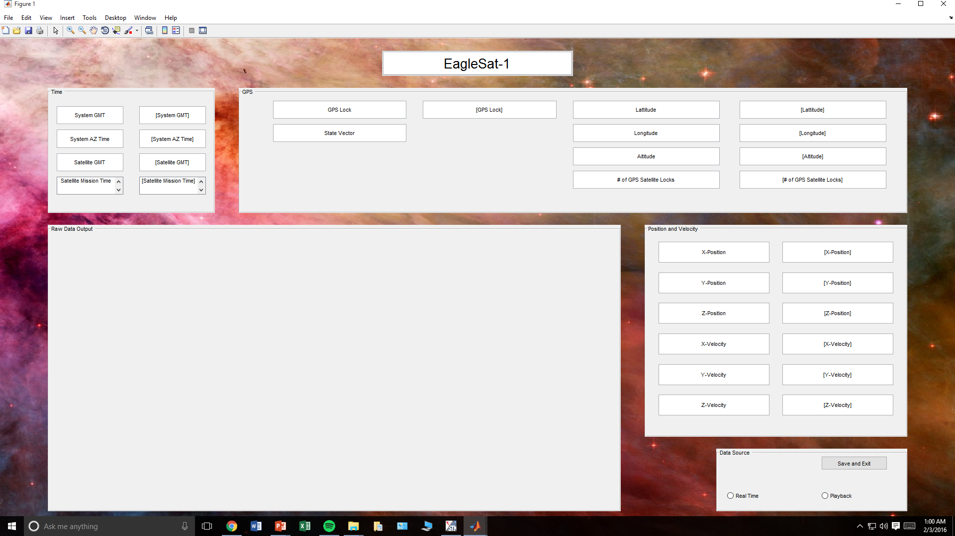
1. Time
2. GPS
4. Position and Velocity
3. Raw Data Output
Position and Velocity
  X, Y, Z position
  X, Y, Z velocity
5. Data Source
  Buttons for real-time or playback
  Save and exit
2. GPS
  GPS Lock
  State Vector
  Latitude and Longitude
  Altitude
  Number of satellite locks
3. Raw Data Output
Time
  System Greenwich Mean Time (GMT)
  System AZ Time
  Satellite GMT
  Satellite Mission Time
5. Data Source

Slide 7

Flight Dynamics
Main objective: To calculate and incorporate drag in order to predict the deorbit time on the EagleSat-I
Orbital Predictions:
  Altitude at apogee: 811.0 km
  Altitude at perigee: 440.0 km
  Inclination: 97.7°
  Assumed launch date: September 21, 2017
All flight dynamics analysis is done in Systems Tool Kit 10 (STK)
Estimated deorbit time: Approximately 9.5 years

Slide 8
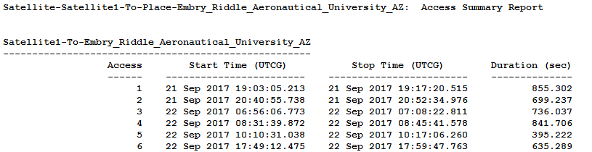
STK Analysis - Coverage
Predicted passes over Ground Station (located in ERAU’s AXFAB)
  3 to 6 passes per day
  2-3 passes within approx. 1-2 hours, separated by approx. 8-10 hour intervals
  Mean coverage time: approximately 10 minutes
Example of STK coverage generation file, based upon the assumed launch date:

Slide 9
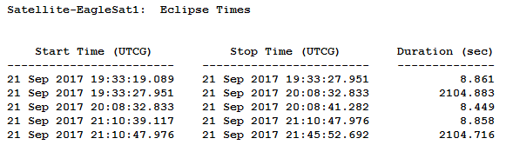
STK Analysis – Eclipse Times
Eclipse Analysis, based upon the assumed launch date
  Eclipse duration: 8 seconds to 36 minutes
  Average eclipse duration: Approx. 12 minutes
  Example of STK eclipse summary:

Slide 10


Acknowledgements
Dr. Gary Yale
Flight Operations team members Kyle Noland, Tyler Noland and Yashica Khatri
EagleSat-I team
Embry-Riddle Aeronautical University
NASA Arizona Space Grant Consortium

Slide 11
Questions?
Madison Padilla
padillm3@my.erau.edu

